Slide 1

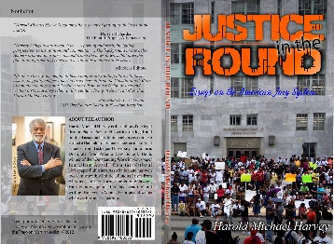

JUSTICE IN THE ROUND
JUSTICE IN THE ROUND
AUTHOR:
Harold Michael Harvey
Media Kit
www.haroldmichaelharvey.com
Notes:
Animated sun with spinning text
(Intermediate)
To reproduce the clip art on this slide, do the following:
On the Home tab, in the Slides group, click Layout, and then click Blank.
On the Insert tab, in the Images group, click Clip Art.
In the Clip Art pane, in the Search for box, enter 00435540. In the Search in list, select Everywhere, and then click Go. Select the clip art file in the pane to insert it into the slide. (Note: If you choose another clip art file, the clip art must be in the Windows Metafile format [.wmf].)
On the Home tab, in the Drawing group, click Arrange, and then click Ungroup.
In the Microsoft Office PowerPoint dialog box, click Yes.
On the slide, select the converted clip art. On the Home tab, in the Editing group, click Select, and then click Selection Pane.
In the Selection and Visibility pane, select the top-level group. On the Home tab, in the Drawing group, click Arrange, and then click Ungroup.
Also in the Selection and Visibility pane, select the Autoshape object, and then press DELETE.
Press CTRL+A to select all of the objects on the slide. On the Home tab, in the Drawing group, click Arrange, and then click Group.
Select the group. On the Home tab, in the Drawing group, click Shape Effects, point to Preset, and then under Presets click Preset 8 (second row, fourth option from the left).
With the group still selected, under Drawing Tools, on the Format tab, in the bottom right corner of the Size group, click the Size and Position dialog box launcher, and do the following:
On the Size tab, under Scale, select Lock aspect ratio.
On the Size tab, under Size, enter 6.27” in the Height box.
On the Position tab, in the Horizontal box, enter 3.89”.
On the Position tab, in the Vertical box, enter 1.55”
To reproduce the text on this slide, do the following:
On the Insert tab, in the Text group, click Text Box.
Drag to draw a text box on the slide.
Enter text in the text box, and then select the text. On the Home tab, in the Font group, select Candara from the Font list, and then select 32 pt. from the Font Size list. Click Italic, and then, in the Font Color list, under Standard Colors select Orange (third option from the left).
Select the text box on the slide, and then under Drawing Tools, on the Format tab, in the Size group, do the following:
In the Shape Height box, enter 7.29”.
In the Shape Width box, enter 7.29”.
Under Drawing Tools, on the Format tab, in the WordArt Styles group, click Text Effects, point to Transform, and under Follow Path select Arch Up (first option from the left).
To wrap the text upside down, at the bottom of the text box, drag the pink adjustment diamond from the center left position in the text box to the lower right corner of the text box.
With the text box still selected, under Drawing Tools, on the Format tab, in the bottom right corner of the Size group, click the Size and Position dialog box launcher, and then on the Position tab do the following:
In the Horizontal box, enter 3.38”.
In the Vertical box, enter 1.04”.
Also under Drawing Tools, on the Format tab, in the Arrange group, click Send Backward.
To reproduce the animation effects on this slide, do the following:
Select the circle clip art on the slide. On the Animations tab, in the Advanced Animation group, click Add Animation, and then under Emphasis click Spin.
On the Animations tab, in the Timing group, in the Start list, select With Previous.
On the Animations tab, in the Timing group, in the Duration box, enter 4.0.
On the Animations tab, in the Animation group, click Effect Options, and then click Clockwise and then click Quarter Spin.
On the slide, select the text box. On the Animations tab, in the Advanced Animation group, click Add Animation, and then under Entrance click Fade.
On the Animations tab, in the Timing group, in the Start list, select With Previous.
On the Animations tab, in the Timing group, in the Duration box, enter 3.0.
On the Animations tab, in the Advanced Animation group, click Add Animation, and then under Emphasis click Spin.
On the Animations tab, in the Timing group, in the Start list, select With Previous.
On the Animations tab, in the Timing group, in the Duration box, enter 3.0.
On the Animations tab, in the Animation group, click Effect Options, and then click Clockwise and then click Half Spin.
On the Animations tab, in the Advanced Animation group, click Add Animation, and then under Emphasis click Spin.
On the Animations tab, in the Timing group, in the Start list, select With Previous.
On the Animations tab, in the Timing group, in the Duration box, enter 1.0.
On the Animations tab, in the Timing group, in the Delay box, enter 3.0.
On the Animations tab, in the Animation group, click the Show Additional Effect Options dialog box launcher, and then do the following:
On the Effect tab, under Settings, in the Amount list, in the Custom box enter 30°, and then press ENTER.
On the Effect tab, under Settings, in the Amount list, select Counterclockwise.
To reproduce the background on this slide, do the following:
On the Design tab, in the Background group, click Background Styles, and then click Format Background. In the Format Background dialog box, click Fill in the left pane, select Gradient fill in the Fill pane, and then do the following:
In the Type list, select Linear.
In the Angle box, enter 90.
Under Gradient stops, click Add gradient stops or Remove gradient stops until two stops appear in the slider.
Also under Gradient stops, customize the gradient stops as follows:
Select the first stop in the slider, and then do the following:
In the Position box, enter 0%.
Click the button next to Color, and then under Theme Colors click Black, Text 1 (first row, second option from the left).
In the Transparency box, enter 0%.
Select the next stop in the slider, and then do the following:
In the Position box, enter 100%.
Click the button next to Color, and then under Theme Colors click Black, Text 1, Lighter 50% (second row, second option from the left).
In the Transparency box, enter 0%.

Slide 2
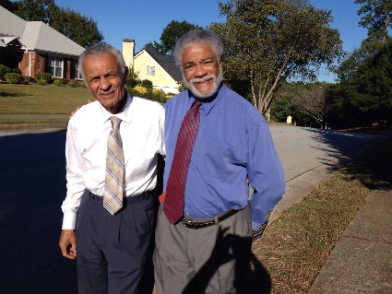

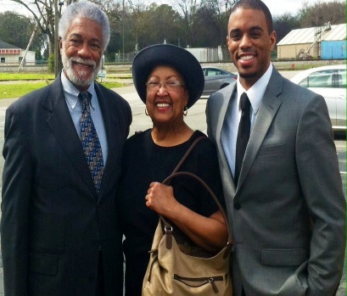
Who is Harold Michael Harvey?
Harold Michael Harvey is an American award winning journalist, former lawyer, political pundit, novelist, essayist and publisher. He earned a degree in Political Science from Tuskegee Institute and a Juris Doctorate degree from Atlanta Law School. Harvey was honored for “Outstanding Work in Newspaper Journalism,” in 1976 by the National Newspaper Publishers Association. The Gate City Bar Association bestowed upon him their prestigious R. E. Thomas Civil Rights Award in 1996 after Harvey represented over 180 college students arrested in the City of Atlanta during a black college spring break ritual known as “Freaknic.”
Harvey is the author of the critically acclaimed legal thriller, Paper Puzzle. It was originally published in 2009 and republished in 2011 after Harvey formed the Cascade Publishing House to publish his works and the works of other authors who feel more comfortable in a small publishing house.
His most recent book, Justice in the Round: Essays on the American Jury System, is a prophetic warning to America that continued injustice in the courts will lead to more unrest in the streets of America. Cascade Publishing House plans to release their third book in December 2015. The book entitled Inspirations from the Steel Curtain is a collection of daily inspirational quotes from J. T. Thomas, a member of the original Pittsburgh Steelers’ Steel Curtain Defense in the 1970s. Allvoices.Com assigned Harvey to cover the 2012 Democratic National Convention which was held in Charlotte, North Carolina. Also, they honored him with two semi-monthly American Pundit Awards, once in February 2012 and again in April 2013.
Harvey lives in Atlanta, Georgia with his wife Cynthia, who has doubled as his editor for the past 35 years. Their son Coley is a Sports Reporter for a national broadcast company. When Harvey can convince Cynthia he needs some quiet writing time, he writes in the Great Smoky Mountains.

Slide 3

What Is the Mission?
Justice in the Round was inspired by the not guilty jury verdict in the George Zimmerman trial for the killing of Trayvon Martin and the hung-jury in the first Michael Dunn trial for killing Michael Jordan. My focus was to understand why two seemingly fair and impartial juries could not see those tragic deaths from the perspective of the black teenagers who were simply exercising their rights as American citizens.

Slide 4
Testimonials
"Brother Harvey, my neighbor, has a unique storytelling ability. In these essays, he gently nudges America to see herself from the Constitutional 3/5th of a human vantage point. I believe there is no better Griot, or oral and written historical storyteller, in this century, living in America today, than Harold Michael Harvey." - Reverend Dr. C. T. Vivian, 2013 Presidential Medal of Freedom Recipient
"Harold Michael Harvey's columns have a way of getting to the heart of the matter." - Darren Richard, The Pundit Project, Allvoices.com
Harvey brings a can-do-spirit to ... reporting and fresh, intriguing perspectives to his opinions and commentary.... His background in law helps readers broaden their horizons and frame the news in ways that have the potential of promoting constructive solutions to contentious issues." - Allvoices Editors
"Justice in the Round" is a MUST-read for all who are struggling to understand what is happening in our Justice System...and why it isn't working for ALL of our citizens." Brenda Blackwelder

Slide 5
Frequently Asked Questions-FAQ
(A) Is Justice in the Round suitable for high school students?
Yes, Justice in the Round is suitable for high school students as well as college students. It is an excellent conversation starter on issues of race in the courts.
(B) Is Justice in the Round a legal treatises?
No, Justice in the Round is written from the layperson perspective. When legal terms are used, they are explained in a way that demystify the law so those terms can be understood by persons without any legal training.
(C) How long is the book?
There are 165 pages in the book. However, there are 155 pages of actual written text.
(D) Is Justice in the Round suitable for book club discussions?
Yes, Justice in the Round is an excellent book club topic because it deals with current issues that are important to every book club member who have children living in America today.
List of bookstores carrying Justice in the Round:
(A) haroldmichaelharvey.com
(B) Amazon
(C) Medu Bookstore, Greenbriar Mall, Atlanta, Georgia
Services Offered:
We are available for book signings at Malls, bookstores, church groups, book clubs, senior citizen centers and schools.
(B) We are available for speaking engagements at high school and universities. Additionally, we will accept speaking engagements at churches, public service media programing and as a commentator on local and national news programs.
Price Packages and rates:
Rates are negotiable and are influenced by travel requirements and accommodations for overnight trips.

Slide 6

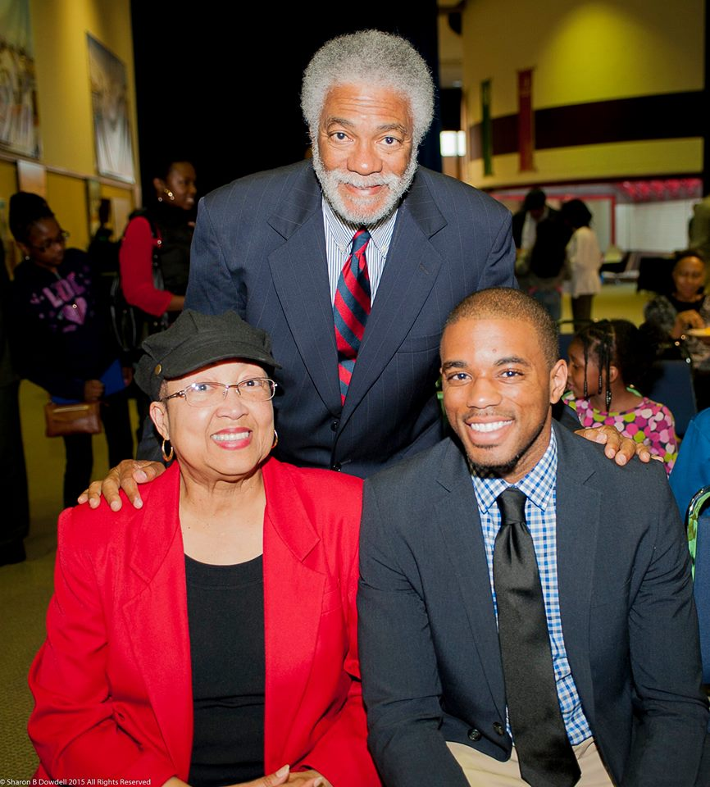
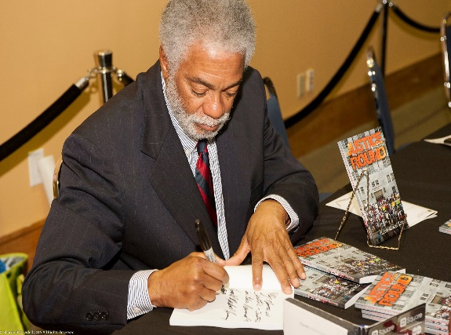
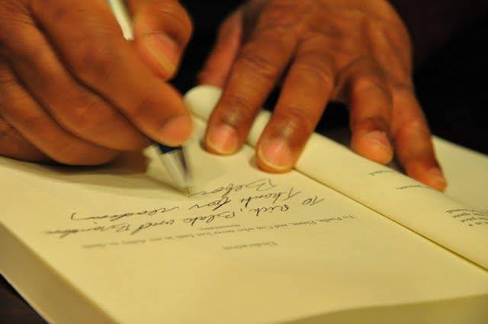
Contact Information
Harold Michael Harvey
(404) 771-0577
Email: hmharvey@Haroldmichaelharvey.com
www.haroldmichaelharvey.com
Twitter: @hmichaelharvey

